Slide 1
Symbolic Scheduling
HARDWARE/SOFTWARE CODESIGN
Presented By
Abdul-Azeez Olanlokun
June, 2022

Slide 2
1
WHAT IS SCHEDULING?.
MOTIVATION
2
HIGH-LEVEL SYNTHESIS

Slide 3
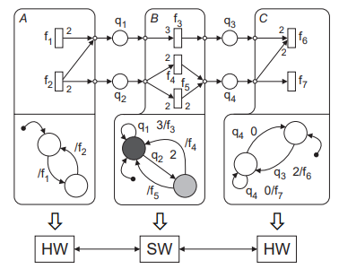
FUNSTATE
What is FunState?
Allows for definite representation of non-determinism and scheduling using functions and state machine.
It combats mixed data/control flow for high-level synthesis.
An Example of FunState [1]

Slide 4
FUNSTATE MODEL OF COMPUTATION
FunState is Made up of two parts
Upper Part, which contains Data-Oriented part that illustrates data flow using Functional units(rectangles) and FIFO queues(circle).
Lower Part, which is the control oriented part that is defined by a finite state machine(FSM).
An Example of FunState [1]

Slide 5
Symbolic Scheduling
WHY SYMBOLIC SCHEDULING?
It helps to prevent explicit listing of execution paths.
It has been proven to be useful ways for doing control/data path scheduling
It also frequently outperform both ILP(Integer Linear Programming) and Heuristic approaches.

Slide 6
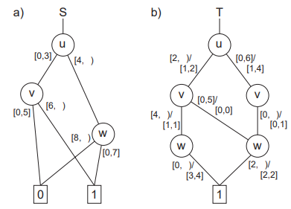
METHODOLOGY
The Methodology for symbolic scheduling is centered on:
Interval Decision Diagram(IDD)
Allows diagram variables to be integers and child nodes be associated with integers rather than single values.
Interval Mapping Diagram(IMD)
Each edge is defined with a condition.
There is just one terminal node in the graph.
An Example of IDD and IMD [2]

Slide 7
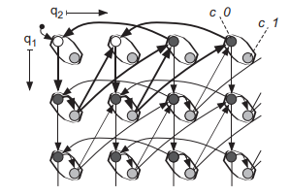
Performing Symbolic Scheduling
The regular state transition graph is explored symbolically
without explicitly creating it using interval diagram techniques.
The generated schedule must be free of deadlocks and must be bounded.
Using a symbolic breadthfirst search to determine the shortest paths.
A Regular state transition graph with schedule[2]

Slide 8
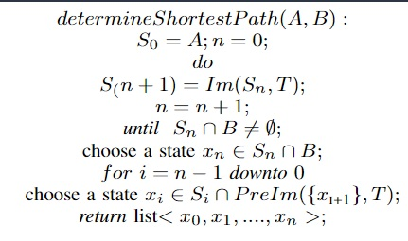
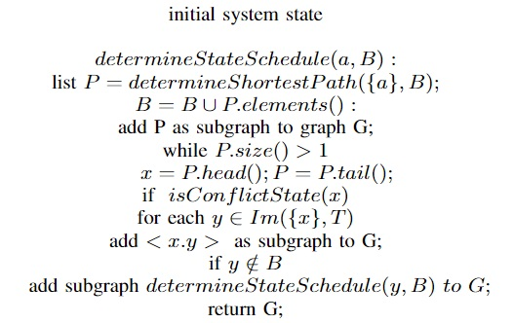
The Algorithms
Algorithm for shortestpath search[3]
Algorithm for state transition of the schedule[3]

Slide 9
DISCUSSION
The Symbolic Scheduling approach was able to manage constraints in the transition graphs through the use of the breadthfirst search algorithm and the state transition algorithm of the schedule.

Slide 10
CONCLUSION
The Symbolic Scheduling as presented was able to combat mixed data/control flow for the design of embedded systems/ high-level synthesis application.

Slide 11
REFERENCES
[1] Lothar Thiele, J ̈urgen Teich, Martin Naedele, Karsten Strehl, and Dirk
Ziegenbein. SCF—state machine controlled flow diagrams. Technical
Report TIK-33, Computer Engineering and Networks Lab (TIK), Swiss
Federal Institute of Technology (ETH) Zurich, Gloriastrasse 35, CH-
8092 Zurich, January 1998.
[2] R. E. Bryant. Graph-based algorithms for boolean function manipula-
tion.IEEE Transactions on Computers, C-35(8):667–691, August 1986.
[3] Karsten Strehl and Lothar Thiele. Symbolic model checking of pro-
cess networks using interval diagram techniques. In Proceedings of
the IEEE/ACM International Conference on Computer-Aided Design
(ICCAD-98), pages 686–692, San Jose, California, November 8–12,
1998

Slide 12
THANKS FOR YOUR
ATTENTION
QUESTIONS?

